Slide 1
Introduction to Robotics Course no. 6
Andrei Dumitriu
andrei.dumitriu@fmi.unibuc.ro
Faculty of Mathematics and Computer Science
University of Bucharest

Slide 2
Today’s plan
Getting started
Short recap from last lab
Homework & Questions
Some feedback
Serial communication
Arduino Memory
Sensors:
Variable resistor sensors
Distance sensors
IRemote

Slide 3
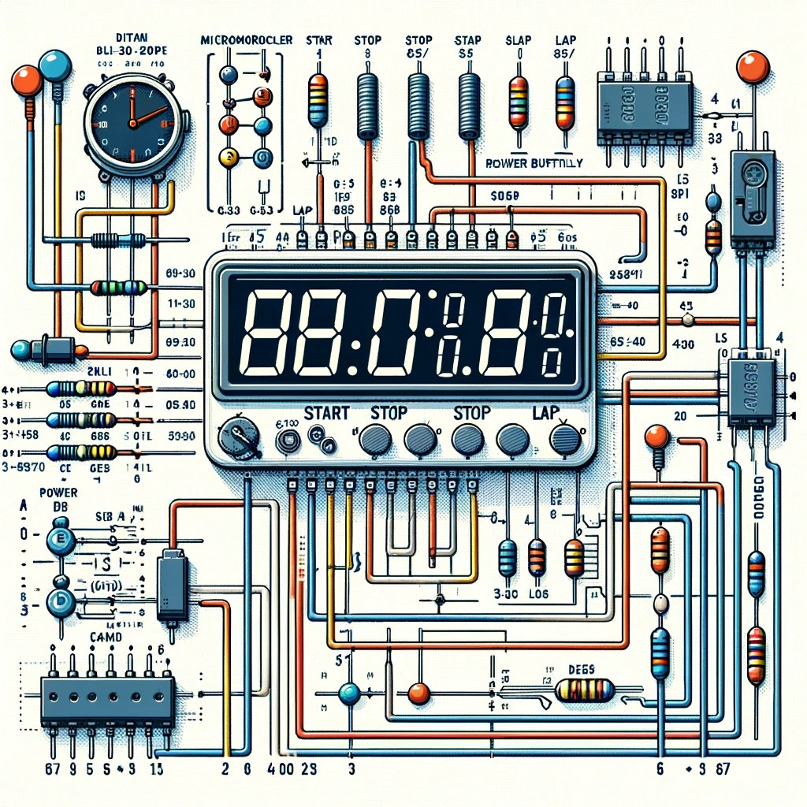
Homework

Slide 4
Arduino Uno Serial Communication
Used for communication between the Arduino board and a computer or other devices. All Arduino boards have at least one serial port (also known as a UART or USART), and some have several.
On Uno, Nano, Mini, and Mega, pins 0 and 1 are used for communication with the computer. Connecting anything to these pins can interfere with that communication, including causing failed uploads to the board.
https://www.arduino.cc/reference/en/language/functions/communication/serial/

Slide 5
Arduino Uno Memory
One essential part of a microcontroller is its memory; memory stores information temporarily or permanently in microcontrollers, and can be used for several purposes.

Slide 6
What is Memory?
Memory blocks are essential parts of modern embedded systems, especially microcontroller-based ones. Memory blocks are semiconductor devices that store and retrieve information or data; a microcontroller central processing unit (CPU) uses and processes data stored in memory blocks to perform specific tasks.

Slide 7
Memory Architectures 101
In the early days of computing, two computer architectures, i.e., the organization of the components inside a computing system, emerged: von Neumann and Harvard.

Slide 8
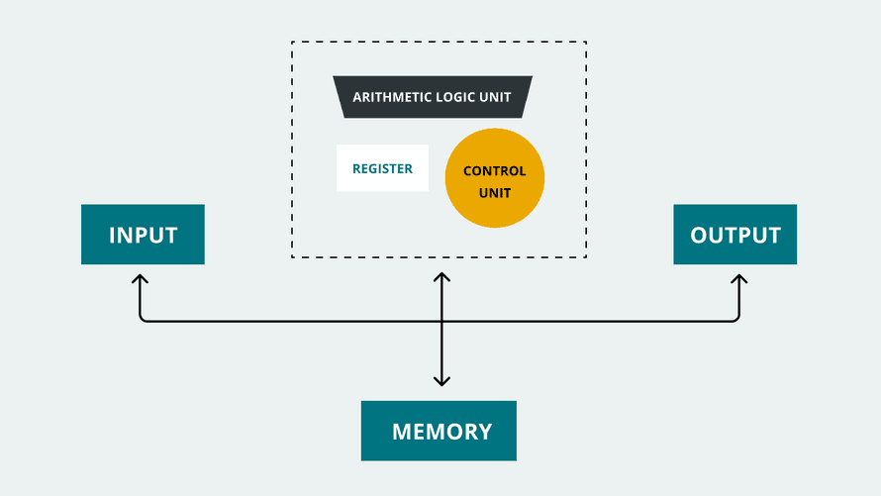
Von Neumann Architecture
The von Neumann architecture, named after the mathematician, physicist, and computer scientist John von Neumann, was first introduced in the mid '40s. It is also known as the Princeton architecture. This architecture stores program data and instructions in the same memory unit.

Slide 9
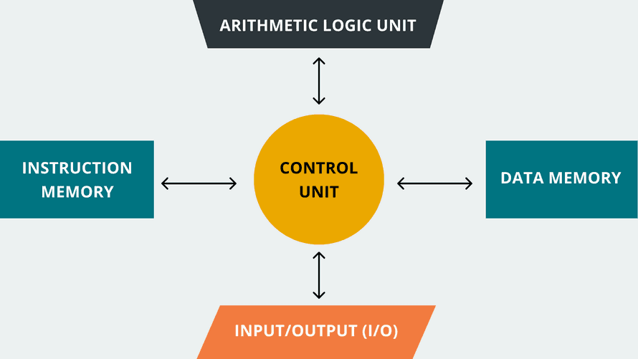
Harvard Architecture
The Harvard architecture, named after the Harvard Mark I relay-based computer, was first introduced in the mid '40s. This architecture's main characteristic is that it uses two separate memory units, one for storing program instructions and one for storing program data. Both memory units in the Harvard architecture are accessed by the CPU using different communication buses.

Slide 10
Hybrid Architectures
These days, most general purpose computers (PC's Mac's etc.) are hybrid designs that give you the best of both architectures. Deep within the CPU they operate on the Harvard model using separate caches for instructions and data to maximize performance. But the instruction and data caches are both loaded automatically from
a common memory space.
From a programming perspective, these computers appear to be pure Von Neumann machines with many gigabytes of virtual storage.

Slide 11
Arduino Memories
There are 3 types of memory in an Arduino:
Flash or Program Memory: 32KB
SRAM: 2KB
EEPROM : 1KB

Slide 12
Flash Memory
Flash memory is used to store your program image and any initialized data. You can execute program code from flash, but you can't modify data in flash memory from your executing code. To modify the data, it must first be copied into SRAM Flash memory is the same technology used for thumb-drives and SD cards.
It is nonvolatile, so your program will still be there when the system is powered off. Flash memory has a finite lifetime of about 100,000 write cycles. So if you upload 10 programs a day, every day for the next 27 years, you might wear it out.
You can also write your own data directly to Flash, but that is rarely recommended: https://www.arduino.cc/reference/en/language/variables/utilities/progmem/

Slide 13
SRAM
SRAM or Static Random Access Memory, can be read and written from your executing program. SRAM memory is used for several purposes by a running program:
Static Data - This is a block of reserved space in SRAM for all the global and static variables from your program
Heap - The heap is for dynamically allocated data items. The heap grows from the top of the static data area up as data items are allocated.
Stack - The stack is for local variables and for maintaining a record of interrupts and function calls. The stack grows from the top of memory down towards the heap.

Slide 14
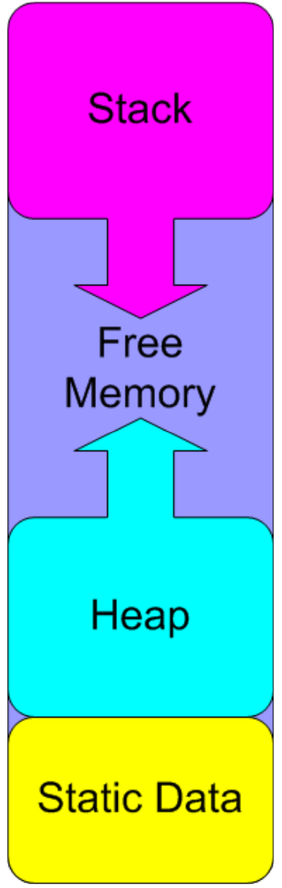
Problems
Most memory problems occur when the stack and the heap collide. When this
happens, one or both of these memory areas will be corrupted with unpredictable results. In some cases it will cause an immediate crash. In others, the effects of the corruption may not be noticed until much later

Slide 15
EEPROM
EEPROM (Erasable Programmable Read-Only Memory) is another form of non-volatile memory that can be read or written from your executing program. It can only be read byte-by-byte, so it can be a little awkward to use.
It is also slower than SRAM and has a finite lifetime of about 100,000 write cycles (you can read it as many times as you want).

Slide 16
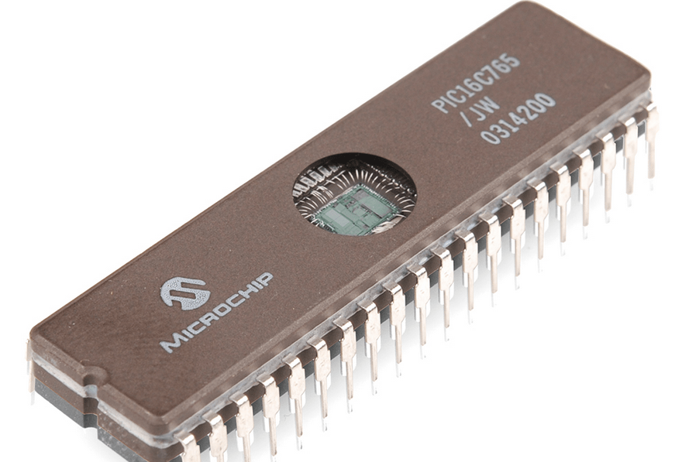
EEPROM - previous versions

Slide 17
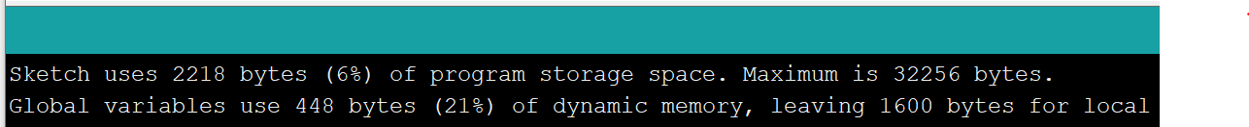
Measuring Memory Usage: Flash
Measuring Flash memory usage is trivial. The compiler does that for you, every time you compile!

Slide 18
Measuring Memory Usage: EEPROM
You are 100% in control of EEPROM usage. You have to read and write each byte to a specific address, so there is no excuse for not knowing exactly which bytes are in use!

Slide 19
Measuring Memory Usage: SRAM
SRAM usage is more dynamic and therefore more difficult to measure. The freeRam() function in the MemoryFree library can help with this.
void display_freeram() {
Serial.print(F("- SRAM left: "));
Serial.println(freeRam());
}
int freeRam() {
extern int __heap_start,*__brkval; //
int v;
return (int)&v - (__brkval == 0
? (int)&__heap_start : (int) __brkval);
}

Slide 20
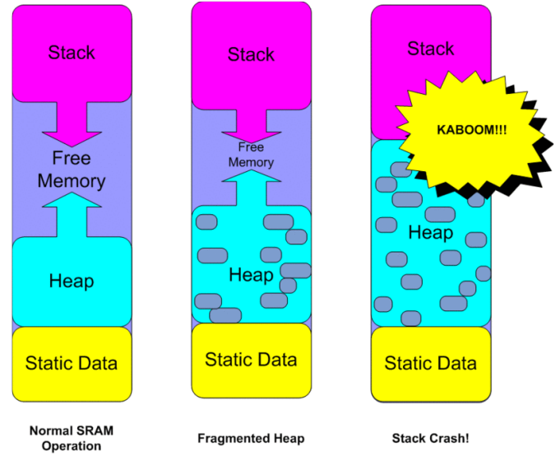
Measuring Memory Usage: SRAM

Slide 21
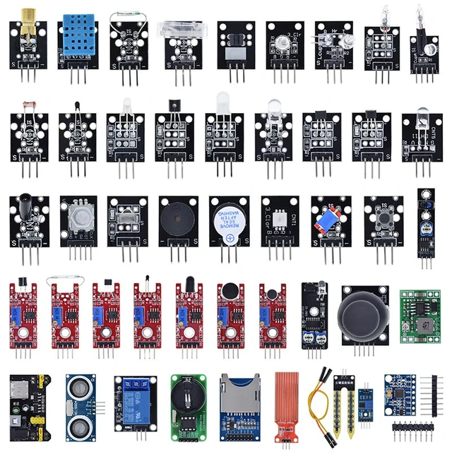
Sensors

Slide 22
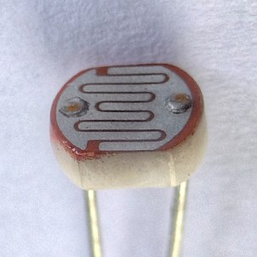

LDR (light-dependent resistor) / photocell / photoresistor

Slide 23
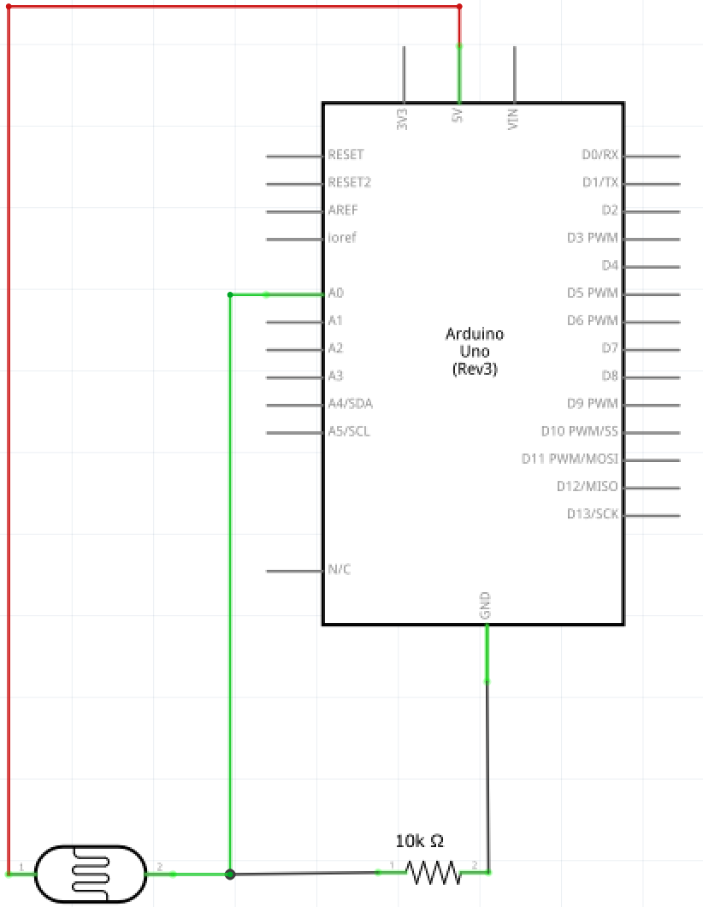
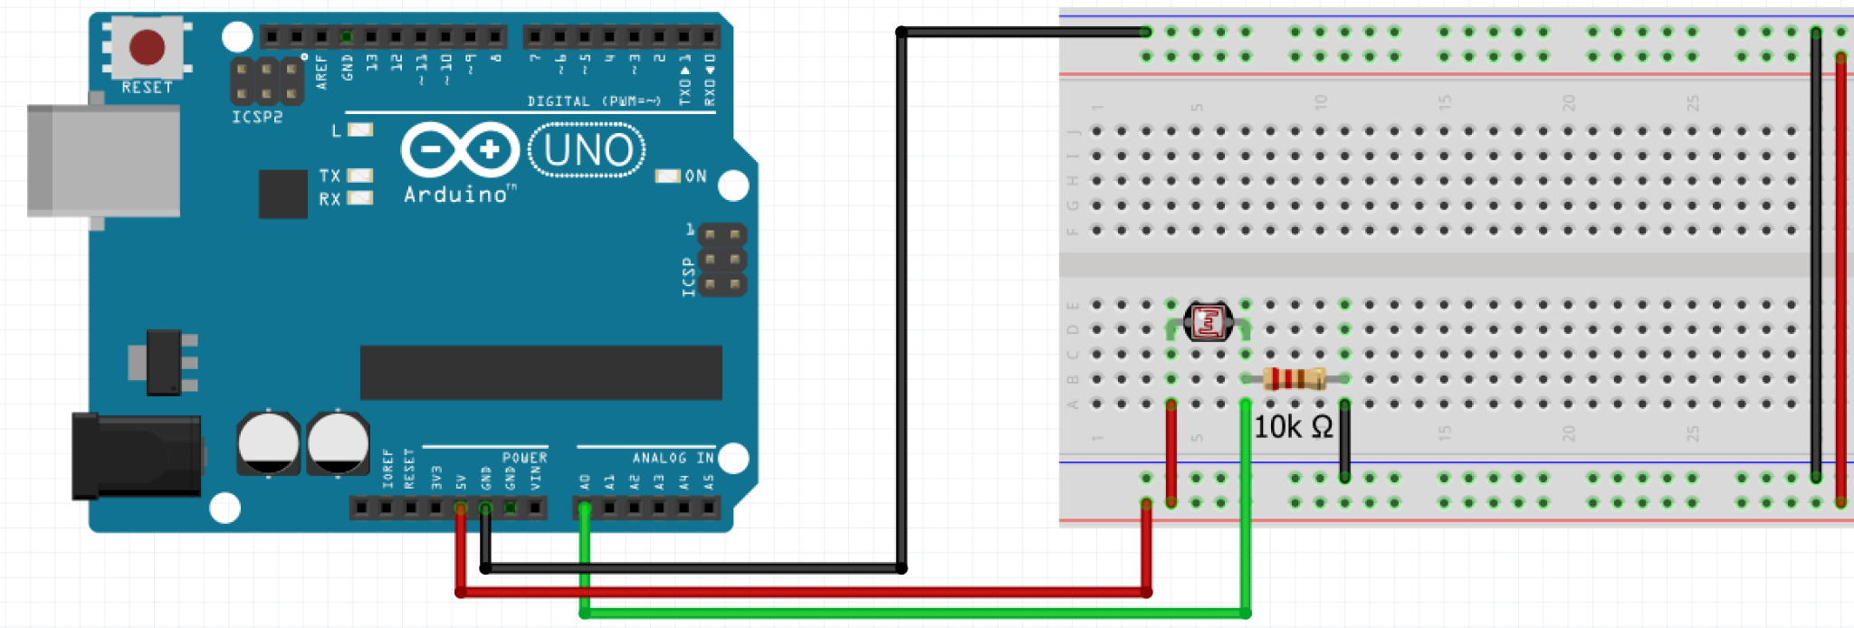
LDR (light-dependent resistor) / photocell / photoresistor

Slide 24
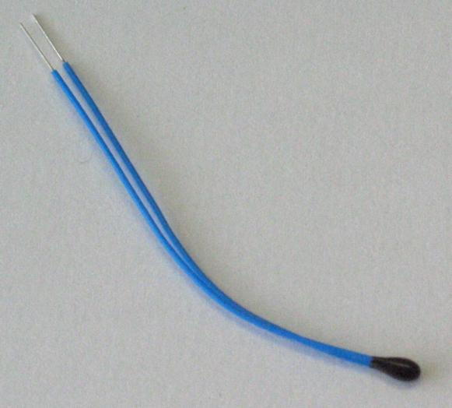
Thermistor
NTC or PTC (Negative / Positive Temperature Coefficient) - resistance decreases or increases as temperature increases

Slide 25
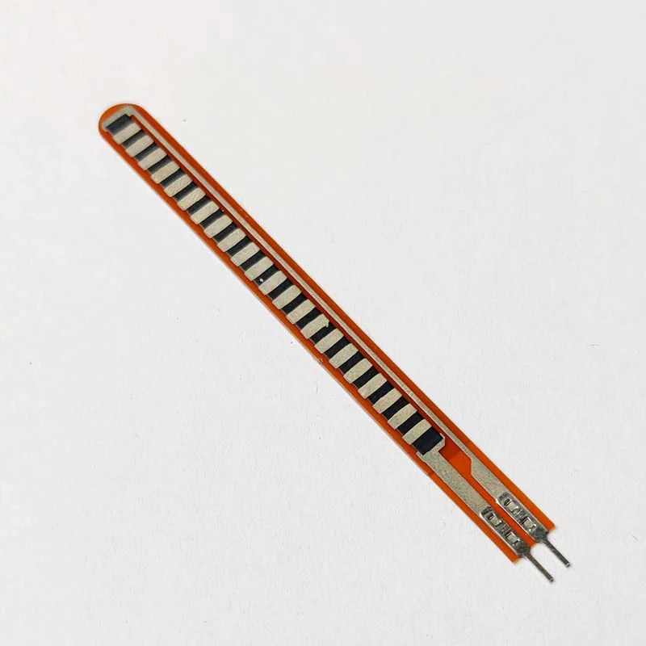
Flex sensor
Changes its resistance when bent. Often used in applications where it's necessary to detect the amount of bend or flex.

Slide 26
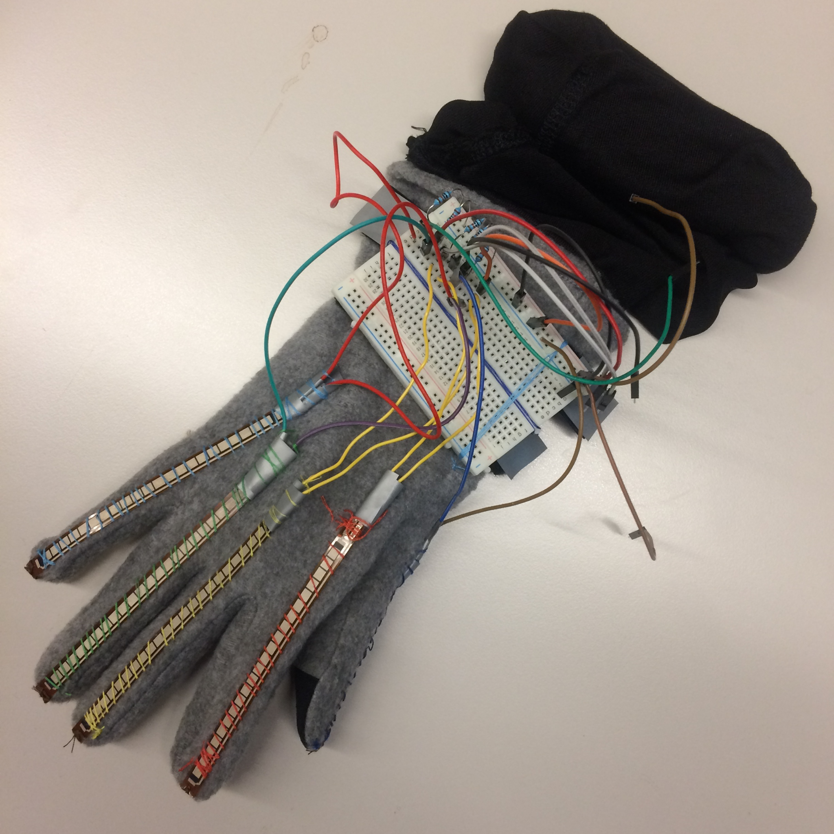
Flex sensor
Changes its resistance when bent. Often used in applications where it's necessary to detect the amount of bend or flex.

Slide 27
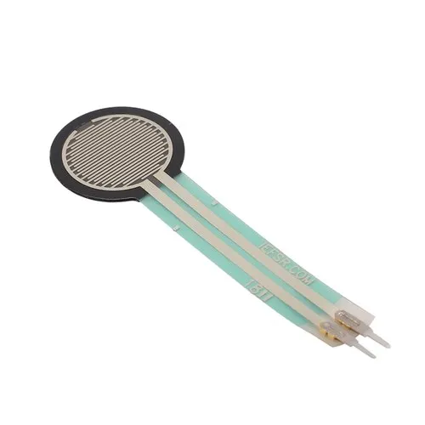
Force-Sensitive Resistor (FSR)
Changes resistance based on the force or pressure applied to its surface. The resistance decreases as the force increases.

Slide 28
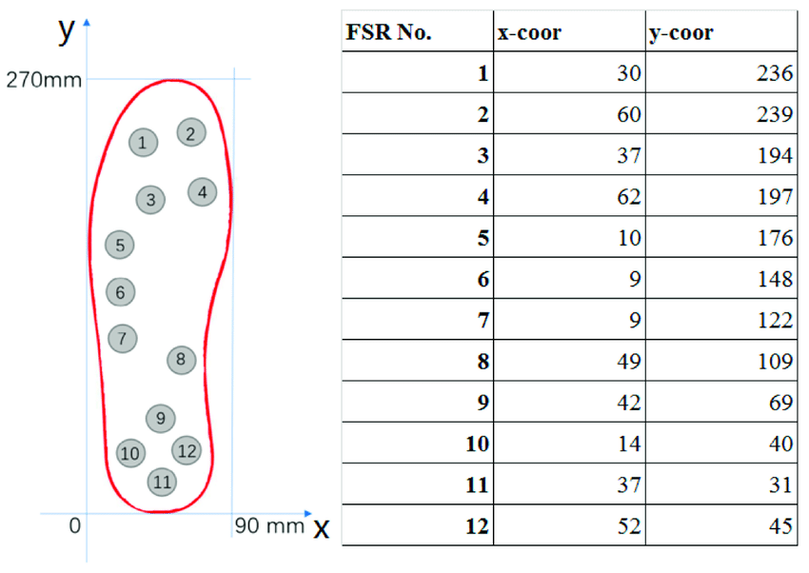
Force-Sensitive Resistor (FSR)
Changes resistance based on the force or pressure applied to its surface. The resistance decreases as the force increases.

Slide 29
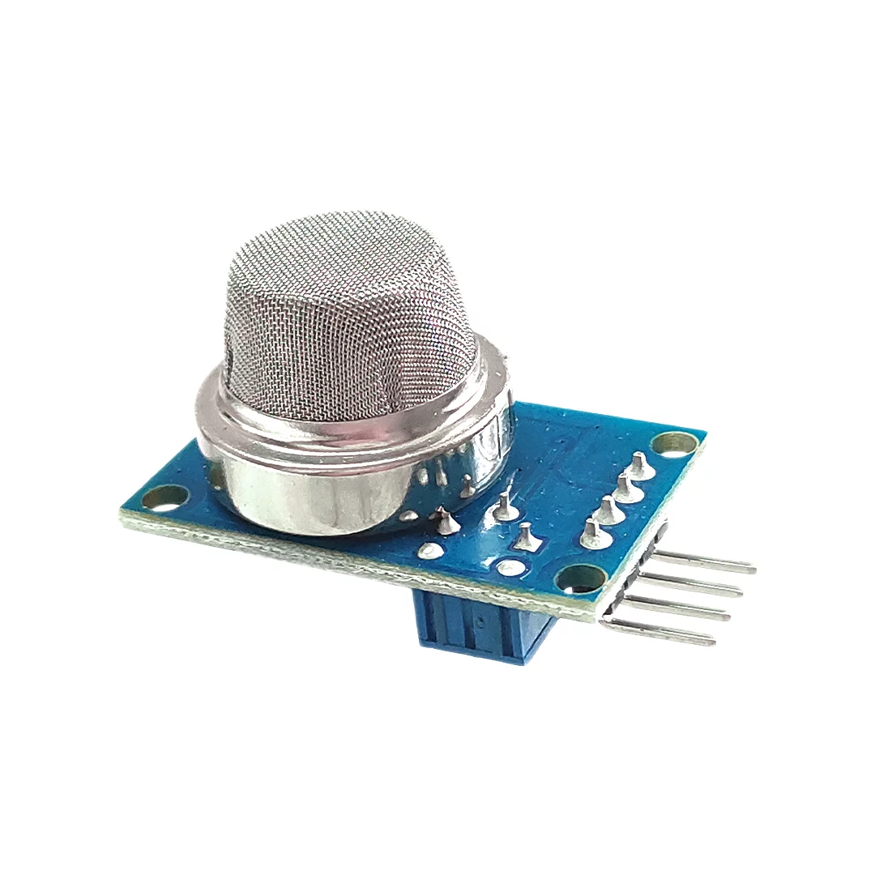
Chemiresistor
Changes resistance in response to changes in the chemical composition of the surrounding atmosphere, often used in gas detection and analysis.

Slide 30
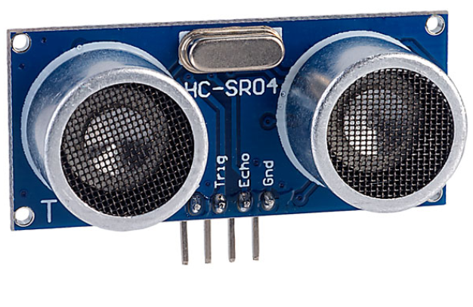
Ultrasonic Sensor HC-SR04
How does it work?
https://cdn.sparkfun.com/datasheets/Sensors/Proximity/HCSR04.pdf

Slide 31
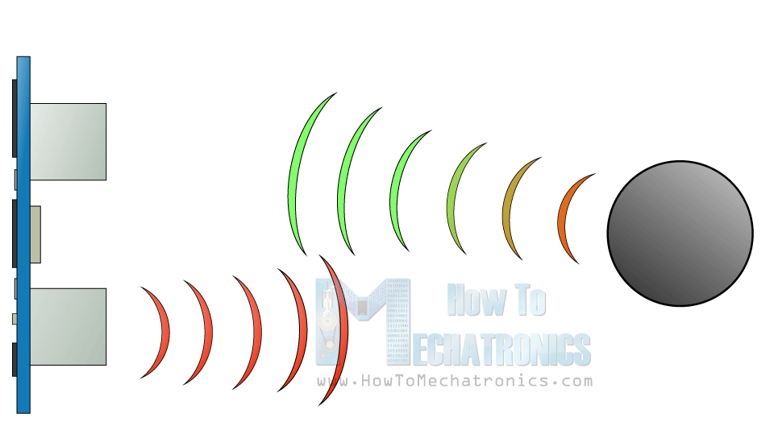
Ultrasonic Sensor HC-SR04
How does it work?
It emits an ultrasound at 40 000 Hz which travels through the air and if there is an object or obstacle on its path It will bounce back to the module. Considering the travel time and the speed of the sound you can calculate the distance.

Slide 32
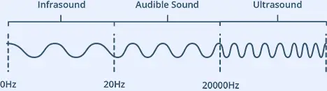
Ultrasonic Sensor HC-SR04

Slide 33
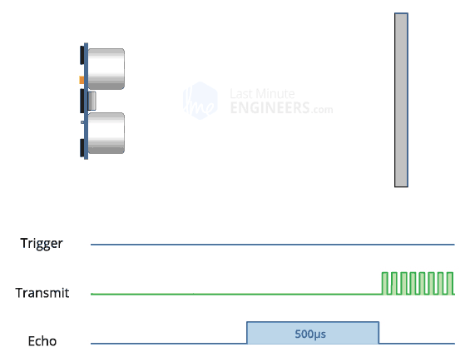
Ultrasonic Sensor HC-SR04

Slide 34
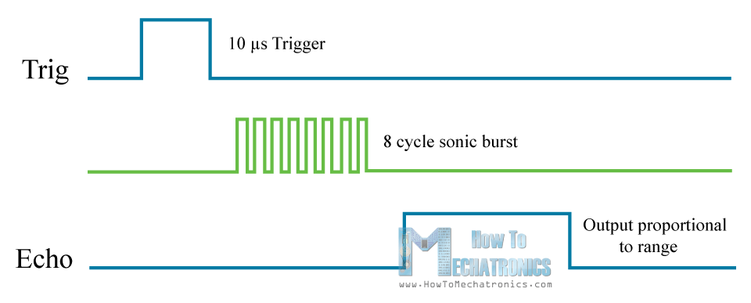
Ultrasonic Sensor HC-SR04

Slide 35
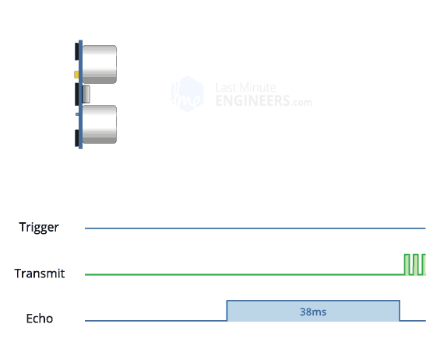
Ultrasonic Sensor HC-SR04

Slide 36
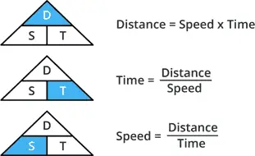
Ultrasonic Sensor HC-SR04

Slide 37
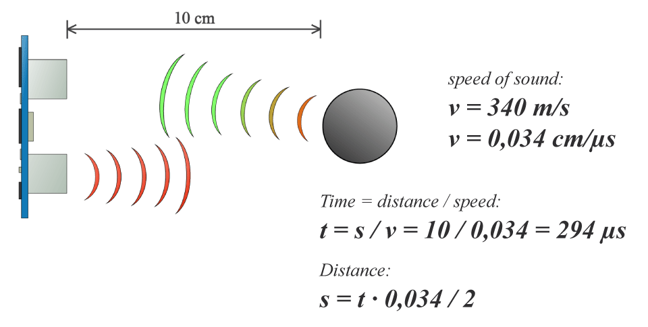
Ultrasonic Sensor HC-SR04

Slide 38
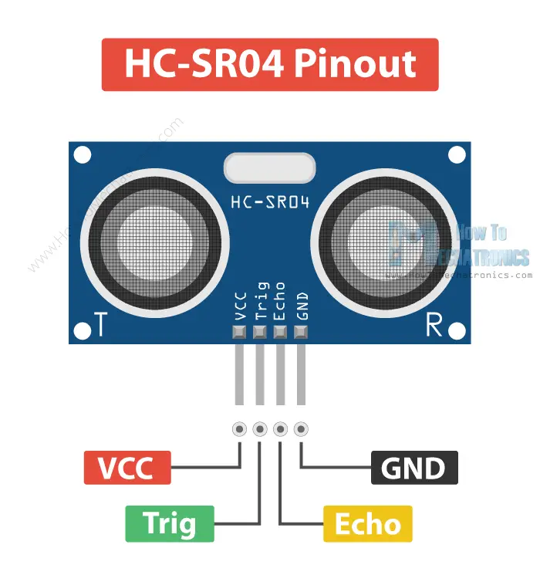
Ultrasonic Sensor HC-SR04
How does it work?

Slide 39
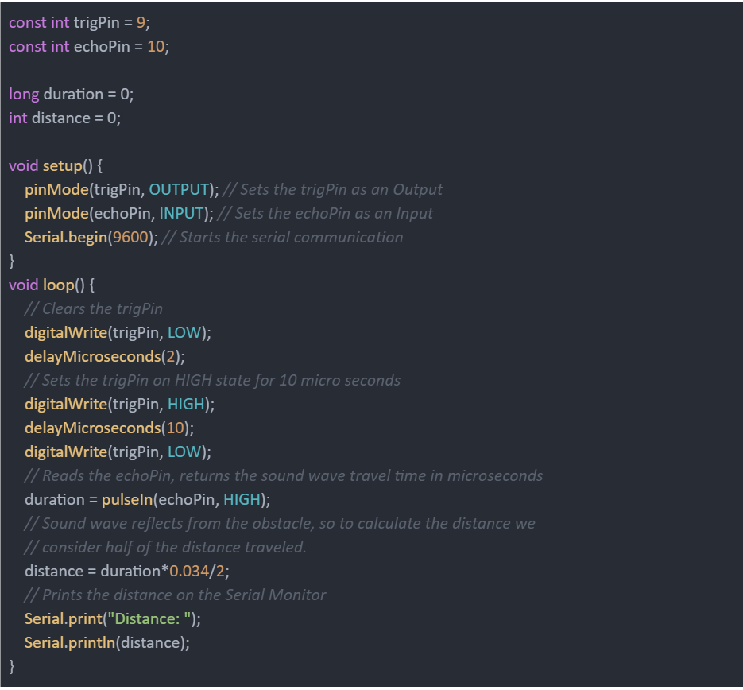
Ultrasonic Sensor HC-SR04

Slide 40
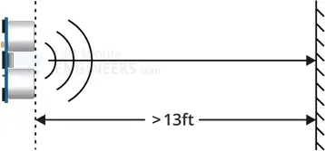
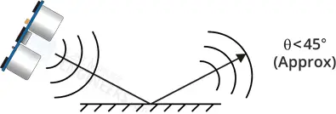
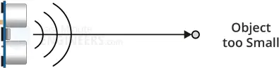
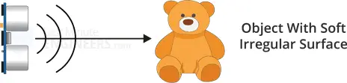
Ultrasonic Sensor HC-SR04 - limitations

Slide 41
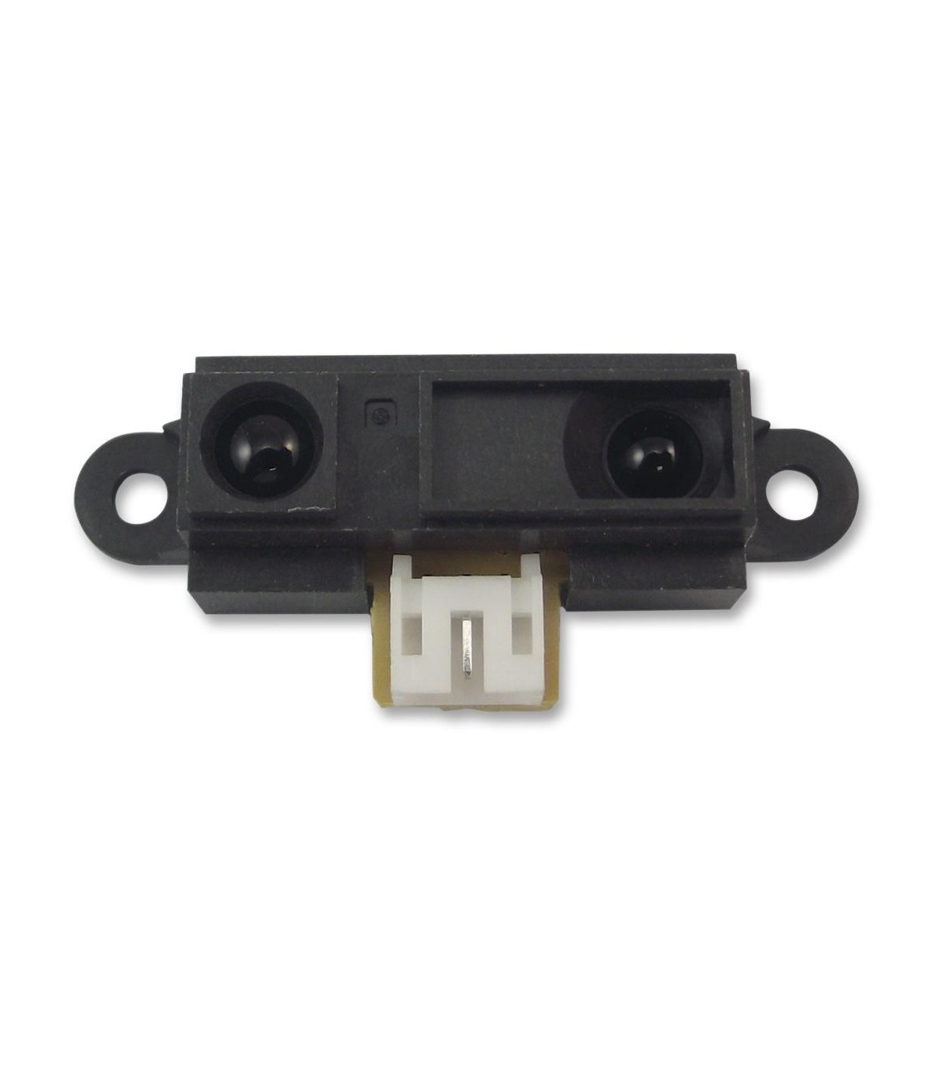
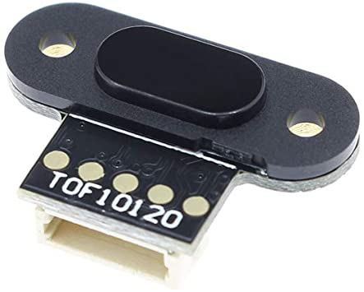
Why ultrasonic? Or better yet, when ultrasonic?
Alternatives include TOF (time of flight) laser sensors and infrared sensors

Slide 42
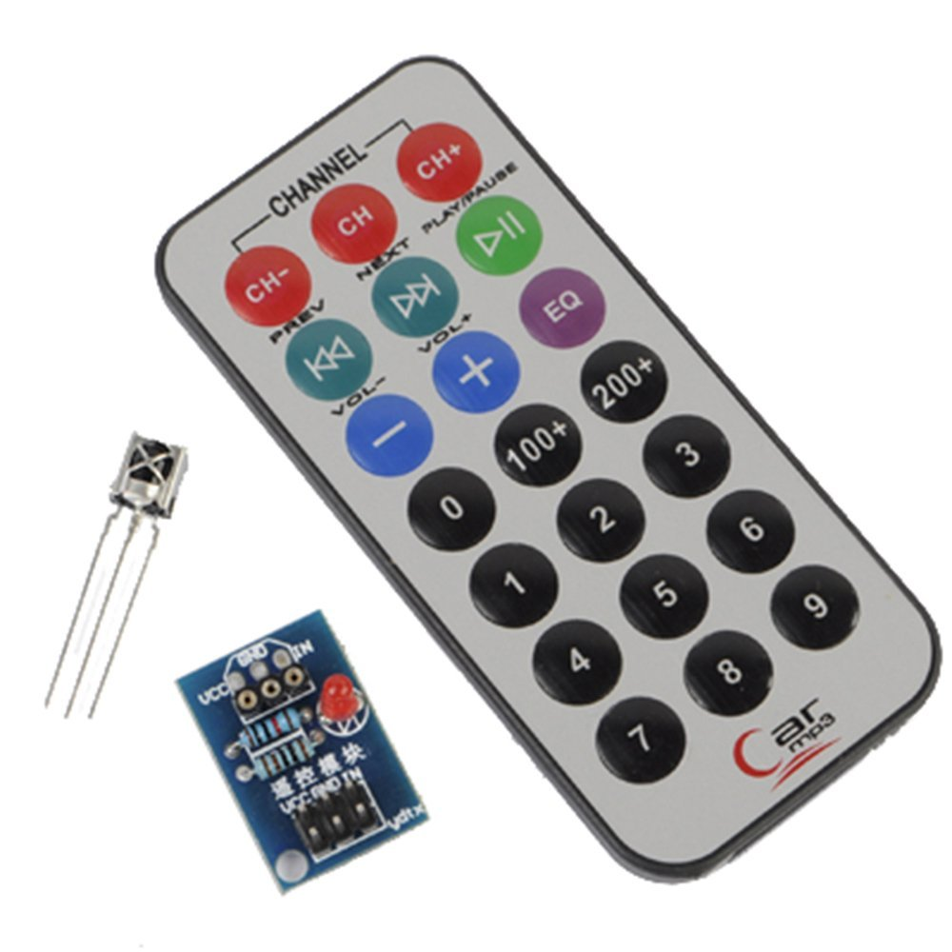
Speaking of infrared...
IR or infrared communication is one of the most common methods of wireless communication due to being easy to use and having an affordable price.

Slide 43
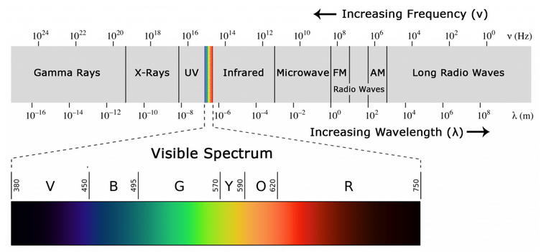
IRremote
Infrared light, with a wavelength longer than visible light, is not within the range of human vision. That’s why it’s a good option for wireless communications.

Slide 44
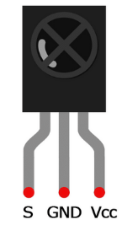
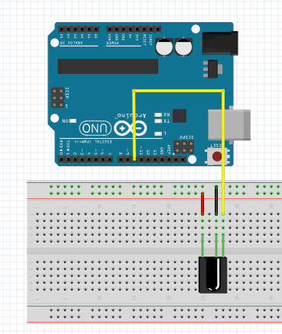
IRremote
When you press a button on your TV control, an LED on your control turns on and off continuously and causes a modulated infrared signal to send from the control to your TV. The command will execute after the signal is demodulated

Slide 45
Resources
https://docs.arduino.cc/learn/programming/memory-guide
https://cdn-learn.adafruit.com/downloads/pdf/memories-of-an-arduino.pdf
https://howtomechatronics.com/tutorials/arduino/ultrasonic-sensor-hc-sr04/
https://randomnerdtutorials.com/complete-guide-for-ultrasonic-sensor-hc-sr04/
https://www.youtube.com/watch?v=lYay_oh7GAw

